Slide 1
Crime Data Analysis Dashboard
L e v e r a g i n g B i g D a t a a n d B I f o r C r i m e T r e n d s A n a l y s i s
Final Project
ECS3301 Big Data
Present by
22UG1-0431 R A P Nirmal
22UG1-0376 K W N Damsika
22UG1-0780 E M T C Ekanayaka
22UG-0413 W P U H Pathirana

Slide 2
Problem Statement and Significance
- Crime rates impact public safety, policymaking, and urban planning.
- Large datasets make it challenging to analyze crime trends effectively.
- Need for an efficient data pipeline and visualization for decision-making.

Slide 3
Methodology and Technologies Used
Dataset: 1.68GB Chicago Police Department crime data
Storage: MongoDB used for store the data files.
Processing: Python Dask for parallelized data cleaning and preprocessing.
Visualization: Power BI to create an interactive dashboard.

Slide 4
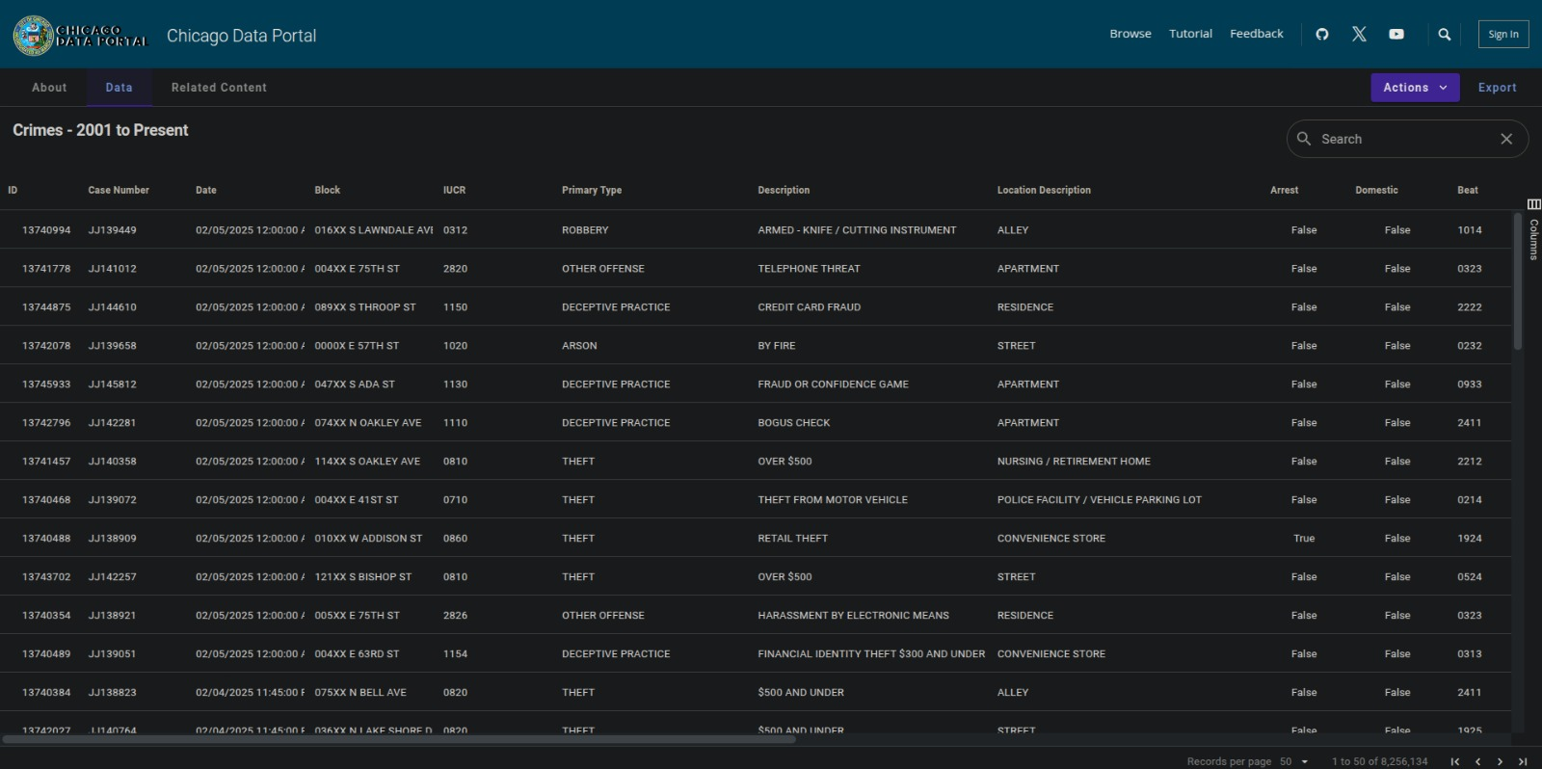
Data Processing and Transformation

Slide 5
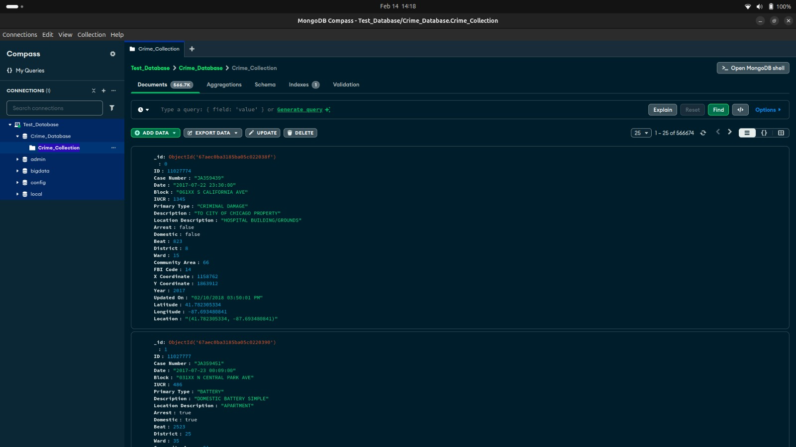

Slide 6
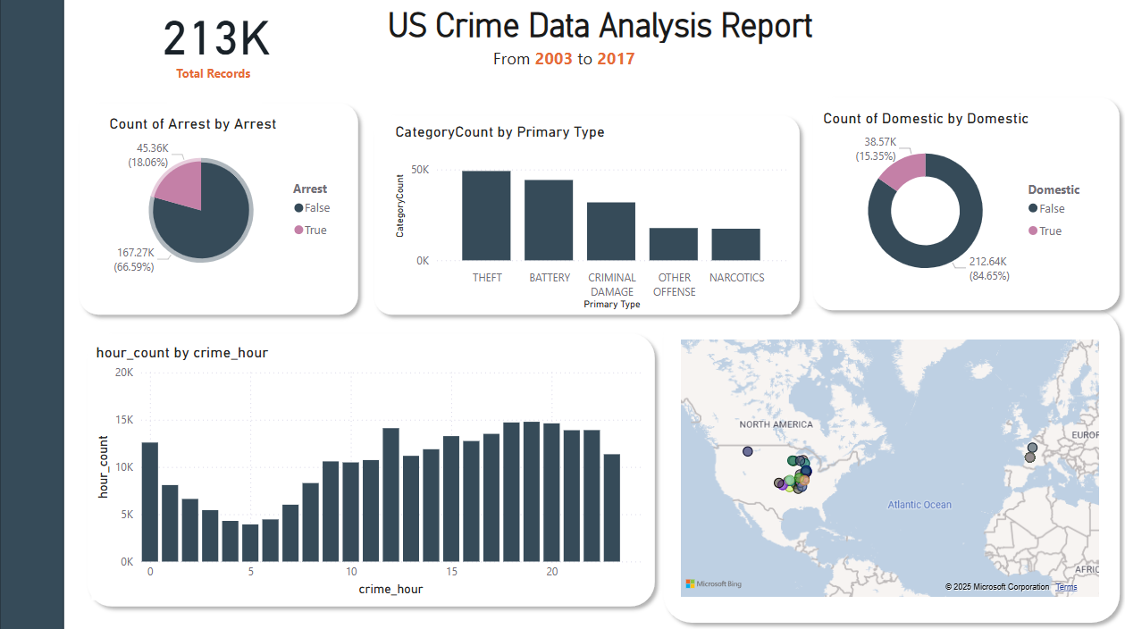
Data Storage and Visualization

Slide 7
Challenges faced and Lessons Learned
Challenges:
Handling large data efficiently.
Performance optimization in data preprocessing.
Lessons Learned:
Efficient data pipeline design is crucial.
Parallel processing tools like Dask improve performance.

Slide 8
Thank You …

